Slide 1
Edge Detection
Edges are significant local changes of intensity in an image

Slide 2
Edge Descriptors
Edge direction:
Perpendicular to the direction of maximum intensity change (i.e., edge normal)
Edge strength:
Related to the local image contrast along the edge normal
Edge position:
The image position at which an edge is located

Slide 3
Detecting the Edge
Original
First Derivative
THRESH

Slide 4

Gradient Approximation
Consider the arrangement of pixels about the pixel (i, j):
The partial derivatives can be computed by:
The constant c implies the emphasis given to pixels closer to the center of the mask
3 x 3 neighborhood:

Slide 5
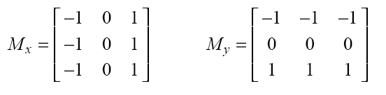
Prewitt Operator
Setting c = 1, we get the Prewitt operator:

Slide 6
Sobel Operator
Setting c = 2, we get the Sobel operator:

Slide 7

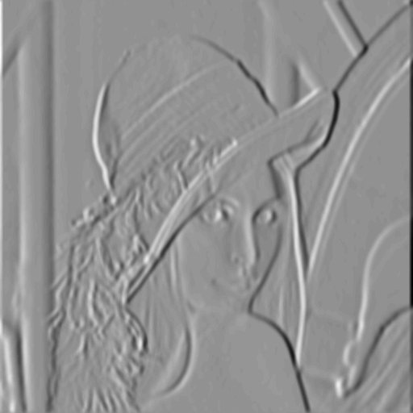
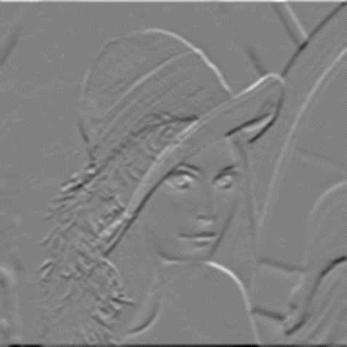
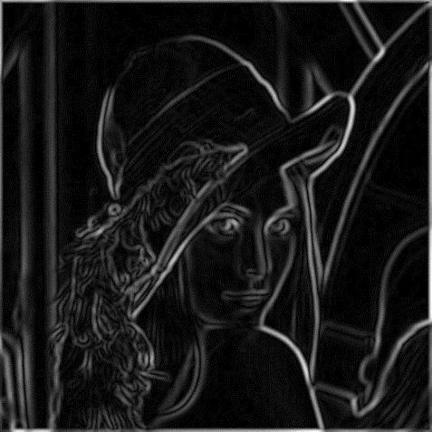
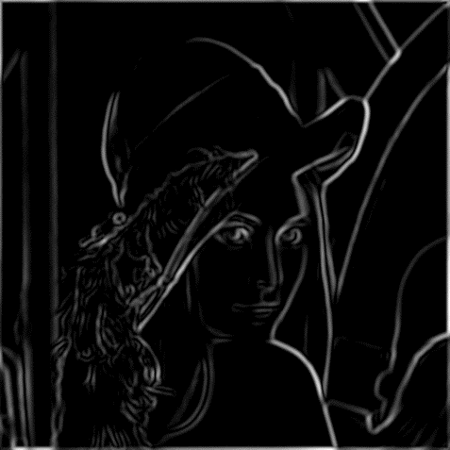
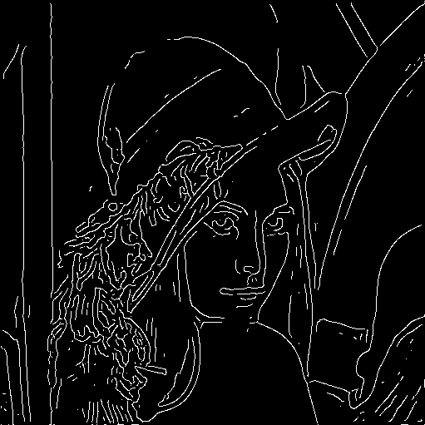
Canny Edge Detector - example
original image
vertical edges
horizontal edges
norm of the gradient
after thresholding
after thinning

